Slide 1
Practical No. 8
Sterilization and Disinfection
Department of Microbiology
College of Medicine

Slide 2
Sterilization: is the killing or removal of all microorganisms, including bacterial spores, which are highly resistant.
Sterilization is usually carried out by autoclaving, which consists of exposure to steam at 121ºС under pressure of [15 lb. / l in ² ] for 15 minutes.
Surgical instruments that can be damaged by moist heat are usually sterilized by exposure to ethyl oxide gas and most intravenous solution are sterilized by filtration.
Disinfection: is the killing of most, but not all microorganisms, mainly the pathogenic ones. For adequate disinfection, pathogens must be killed but some organisms and bacterial spores may survive.
Disinfectants vary in their tissue-damaging from the corrosive phenol-containing compounds, which should be used only on inanimate objects, to less toxic materials such as ethanol and iodine which can be used on skin surface.
Chemicals used to kill microorganisms on the surface of skin and mucous membrane are called antiseptics.

Slide 3
Classification of sterilizing agents:
1-physical agents:
heat
Filtration
Radiation.
2- Chemical agents.
Of all the physical agents that exert antimicrobial effects, heat is the most effective. It is an excellent sterilizing agent when applied in appropriate intensity for an adequate period of time, for it effectively stops cellular activates.
Depending on whether it is moist or dry, heat can coagulate cellular proteins (think of a boiled egg) or oxidize cell components (think of a burned finger or a flaming piece of paper).

Slide 4
STERILIZATION METHODS
VARIOUS METHODS EMPLOYED
CLASSIFICATION
CHEMICAL AGENTS
PHYSICAL AGENTS

Slide 5
physical mean of sterilization.
1-Heat: Glassware and medium are routinely sterilized by heat. The method depends on the effective oxidation of the microorganisms by carbonization or the coagulation of the protoplasm.
A. Dry Heat:
1. Direct flame: whenever rapid and repeated sterilization is required, the simplest method is direct flaming. This Type of sterilization is used for metal instruments such as platinum wire loop, forceps and scissors etc.
Bunsen burner is commonly used for sterilization by dry heat (direct flame).
2. Hot air: All dry glassware and metal instrument are usually sterilized by this method. Generally, the instruments are left in a Hot Air Oven on a temperature of 160-180ºС for one hour.
3. Incineration: The use of electrically heated or gas-fired incineration filled with forced air blower units provide an excellent means of rapidly destroying articles such as solid dressings, pathological material, animal caresses and bedding.

Slide 6
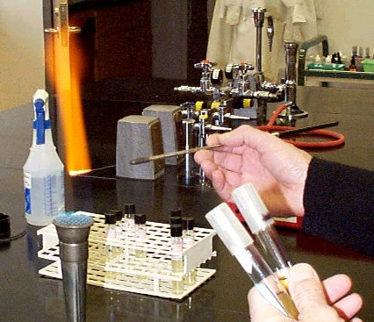
FLAMING
A simple & effective method.
Loops or wires, needle , glass slides, cover slips
Instruments held on a Bunsen flame till red-hot.

Slide 7
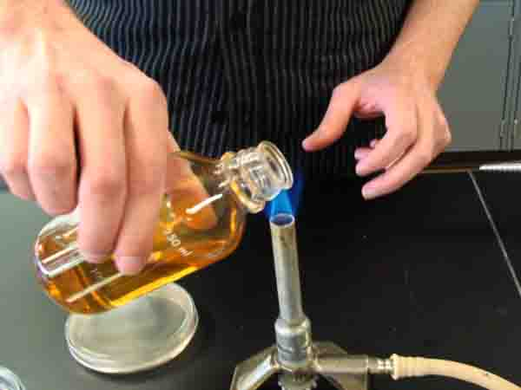
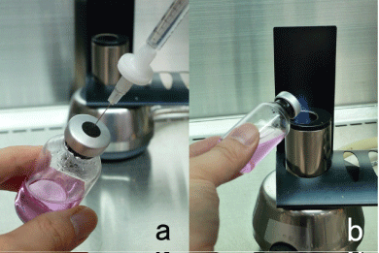
flaming

Slide 8
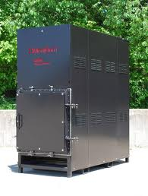
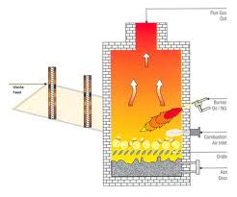
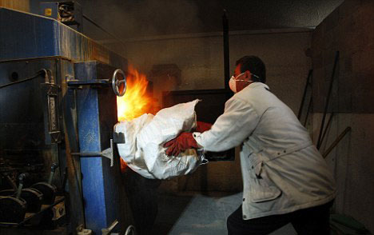
incinerator

Slide 9
B-moist heat:-
1.pasteurization: uses heat 63ºС at 30ºС minutes.
The organisms such as Brucella or Salmonella and tubercle bacilli which contribute to milk born-disease are readily killed by this process. The alternative method raises the temperature of milk to 72 ºС (161 º F) for 15-20 seconds and is referred to as the flash process.
N.T: bacterial spores are not killed by this method.
2.Boiling water: A temperature at 100ºС will kill all non-sporing or vegetative organisms within 10 minutes. Most spores will be killed in 30 minutes at this temperature, but some spores will resist boiling for several hours. The addition of 2% sodium carbonate increases the disinfecting power of the water, and spores resistant to boiling water for 10 hours have been killed in 30 minutes by this addition.
This method is suitable for infected instruments or small pieces of infected glassware and also for instruments (such as animal autopsy).
3.Steam at 100ºС:the process of sterilization by intermittent steaming (or boiling) is called Tyndallization.
4.Steam under pressure (high pressure steam): The autoclave or pressure cooker is the instruments used for high pressure steam sterilization. Then steam is placed under pressure in an autoclave.
Bacteriological media, surgical instruments are sterilized in the autoclave at 121ºС (15 Ibs) for 15 minutes.

Slide 10
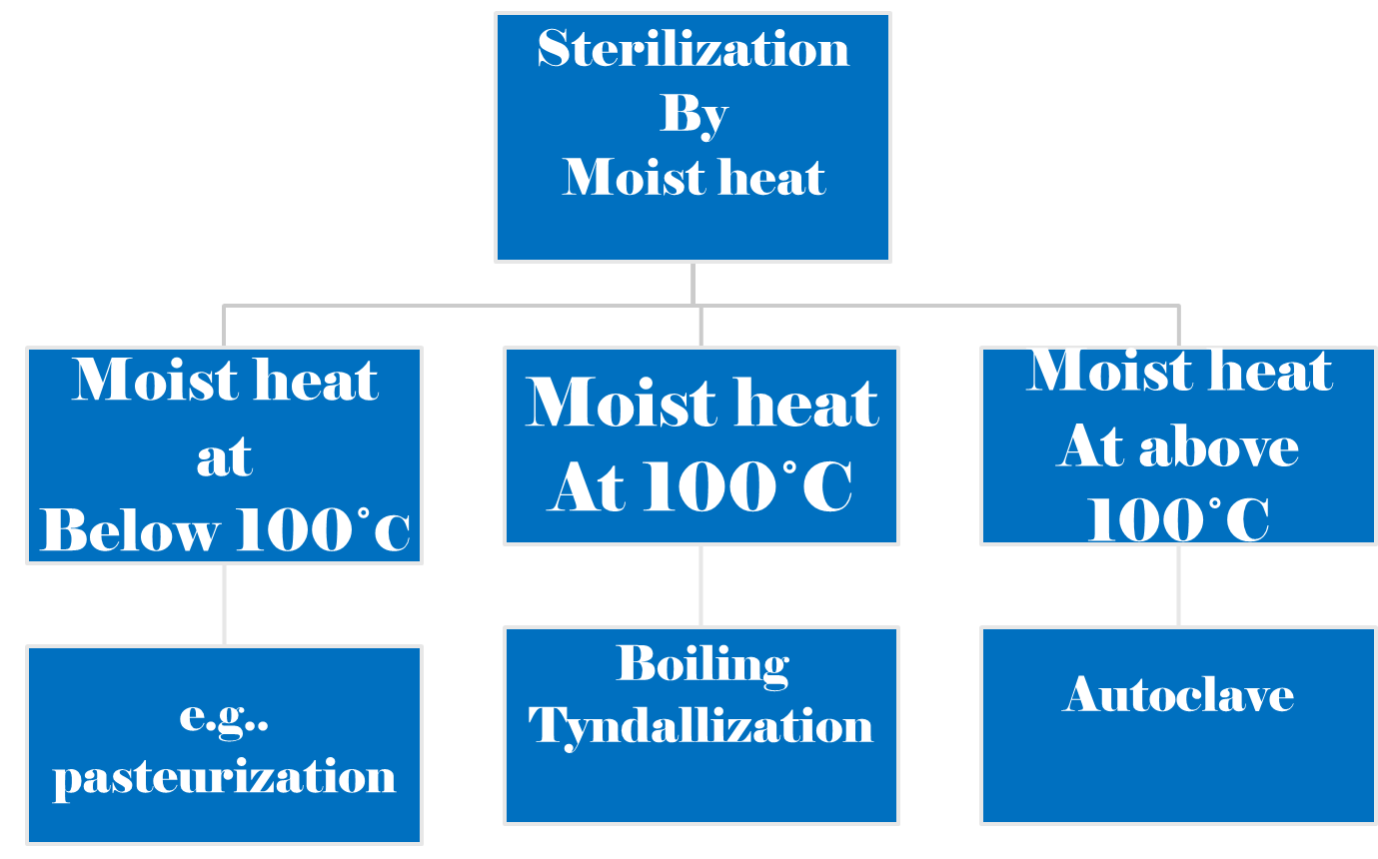
MOIST HEAT

Slide 11
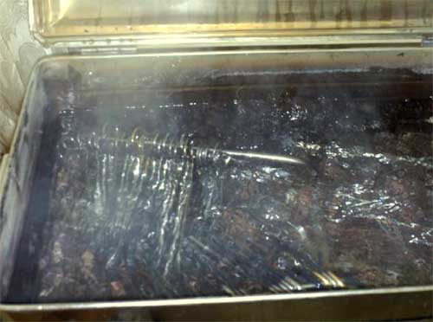
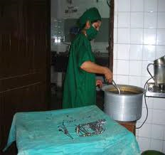
boiling

Slide 12
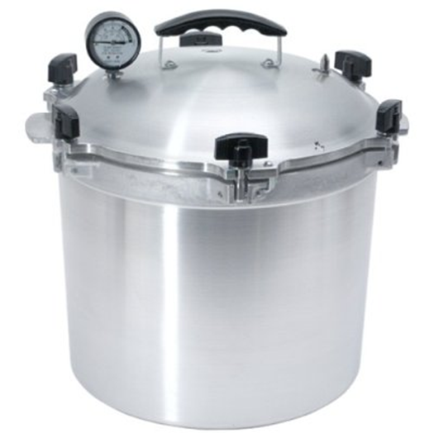
Autoclaving (At a temperature above 100Cº)
Steam under increased pressure, this is called (autoclaving) Under autoclave conditions, pressurize steam KILLS bacterial spore, vegetative cells and other microbial forms.

Slide 13
2.Filtration: The principle of this method is to pass the material to be sterilized through special bacterial filters which hold back any bacteria present; the filtrate is thus obtained bacteria free.
This method is used for the sterilization of fluids that do not withstand heating, e.g. sera, Plasma, Vitamins and antibiotic solutions.
Several kinds of bacterial filters are available. The kinds which are most used are the chamborlain and Daulton filters which are made of unglazed porcelain, the Mandler Fillters ,Seitz filters, etc. .
Either positive pressure on the liquid to be filtered should be exerted or negative pressure by sucking from the filtrate container on the filtration in order to enhance the process.
3.Radiation: It is employed commercially for the sterilization of large amount of pre-packed disposable items such as plastic syringes and Catheters that are unable to withstand heat. It is done by applying ultra-violet rays, this process induces thymine dimmer of DNA and this interferes with replication of Micro-organism.

Slide 14
Experiment:
Materials Provided:
1-Nutrient Broth (4 tubes to each group)
2-Sterile forceps
3-Sterile paper strips
4-Broth culture of E. coli and B. subtilis

Slide 15
Procedure:
a- Contaminate 4 strips by dipping them into one of the cultures supplied.
b- Place one strip in a broth bottle, labeled ''Control''.
c- Place a second strip into a broth bottle and hold in boiling water bath for 15 min.
d- Place a third strip into a broth bottle and autoclave at 15 atm. pressure for 15 minutes.
e- Place the fourth strip into 70% alcohol, leave for 15 minutes shake off the alcohol and drop the strip into a broth bottle.
f- Label all bottles (or tubes) with organism and treatment.
g- Incubate them at 37ºС for overnight.
h- Record the results.

Slide 16
Chemical mean of sterilization.
1-Alcohols Etyhl alcohol, Isoporopylalcohol (70% aqueous solution):
uses:
Antiseptic to sterilize the thermometer, the skin before injection vein puncture.
2-Phenols:
Uses:
sterilization of surgical instruments, bathroom, hospital floor.
Chlorohexidin ; as skin disinfectants.
3-Heavy metal ions (metallic salt); (Mercury, siliver nitrate):
Uses:
Mercuric salt e.g Methiolate used as preservation for sera, bacterial and viral vaccine.
Silver salt e.g AgNO3 (1%) used as eye drop for newborn infants to prevent infections by Neisseria gonorrhea.

Slide 17
4-Oxidizing agent.
H₂O₂
Uses: mainly, for disinfection of contaminated wounds.
5- Halogens : chlorine and hypochlorite, iodine
Uses: to disinfect the swimming pools and water supplies: Hypochlorite as bleaching powder.
6-Akalyting agents
a. Formaldehyde. used in the sterilization of instruments, lab and surgical theatre, clothing, books by fumigation.
b -Ethylene oxide used to sterilize heat sensitive objective such as plastic Petri dishes, tubes, syringes, pipettes.
7-Detergents:
*Soaps to clean the skin.
*quaternary Compounds used as antiseptic and disinfectant.
Purpose: To study activity of some disinfectants and to learn the importance of time, germicidal concentration, and microbial species in disinfection.

Slide 18
Experiment:
Materials Provided:
Tubes of nutrient broth
Sterile, empty tubes
Sterile, 10-ml pipettes (cotton plugged)
Sterile, 1.0-ml pipettes (cotton plugged)
1.0 per cent phenol, 2.0 per cent phenol
Absolute alcohol, 70 per cent alcohol
3.0 per cent hydrogen peroxide
1.0 per cent Lysol, 5 per cent Lysol
Tincture of iodine
Antiseptic mouthwash
24-hour nutrient broth culture of Escherichia coli
Three-to-six-day-old culture of Bacillus subtilis

Slide 19
Procedures:
1- Select one of the chemical agents. Draw 5.0ml of the solution into a sterile test tube.
2- To the 5ml of disinfectant, add 0.5ml of the E. coli culture. Gently shake the tube to distribute the organisms uniformly. Note the time.
3- At intervals of 2, 5, and 10 minutes, transfer one loop full of the disinfectant-culture mixture to a tube of fresh nutrient broth. Label each broth tube with the name of the organism, the disinfectant, its concentration, and the time of exposure (for example, E. coli, 1 percent phenol, 2 minutes).
4- Using the same concentration of the same disinfectant, repeat procedures 1 to 3 with the culture of
B. subtilis.
5- Inoculate a tube of nutrient broth directly from the E. coli culture and another from the B. subtilis culture. Label each tube with the name of the organism and the word ''Control''.
6- Incubate all tubes at 35ºС for 48 hours.
7- Record your results.

Slide 20


